Slide 1
Facial Emotion Recognition with facial gestures
Done by
Nivedha M
Rahul R
Pragatheeshwari B.K

Slide 2
Why emotion detection ?
Human emotion recognition plays an important role in the interpersonal relationship.
The automatic recognition of emotions has been an active research topic from early eras.
Hence extracting and understanding of emotion has a high importance of the interaction between human and machine communication.

Slide 3
Facial emotion recognition by cnn
Data Pre-processing
Image augmentation
3. Training
4. Validation

Slide 4
Dataset description
The original FER2013 dataset in Kaggle is available as a single csv file.
The dataset is converted into images in PNG format for testing and training.
The data consists of 48x48 grayscale images of faces. The faces has been categorized into facial expression into one of seven categories.
0=Angry 4=Sad
1=Disgust 5=Surprise
2=Fear 6=Neutral
3=Happy

Slide 5
Data PreProcessing
Data preprocessing is an integral step in Machine Learning as the quality of data and the useful information that can be derived from it directly affects the ability of our model to learn; therefore, it is extremely important that we preprocess our data before feeding it into our model.
Steps involved in preprocessing
Data cleaning
Data integration
Data reduction
Data transformation

Slide 6
image Augmentation
More data is generated using the training set by applying transformation
It is required if the training set is not sufficient enough to learn representation.
The image data is generated by transforming the actual training images by rotation, crop, shift, shear, zoom, flip, reflection etc.,

Slide 7
Training & Testing
Training set is implemented to build up a model and to fit the model to test it.
Testing set is used to validate a model built after training.
The models generated are to predict the results unknown which is named as the test set.

Slide 8
Validation
In the validation phase, various OpenCV functions adn keras functions have been used.
Initially the video frame is stored in a image object
An harr-cascade classifier is used to detect facial region of interest.
The image frame is converted into grayscale and resized and reshaped with the help of numpy.
This resized image is fed to the predictor which is loaded by keras.models.load_model() function .
The Soft Max Score among the list is the output.
A rectangle is drawn around the facial regions and the output is formatted above the rectangular box.

Slide 9
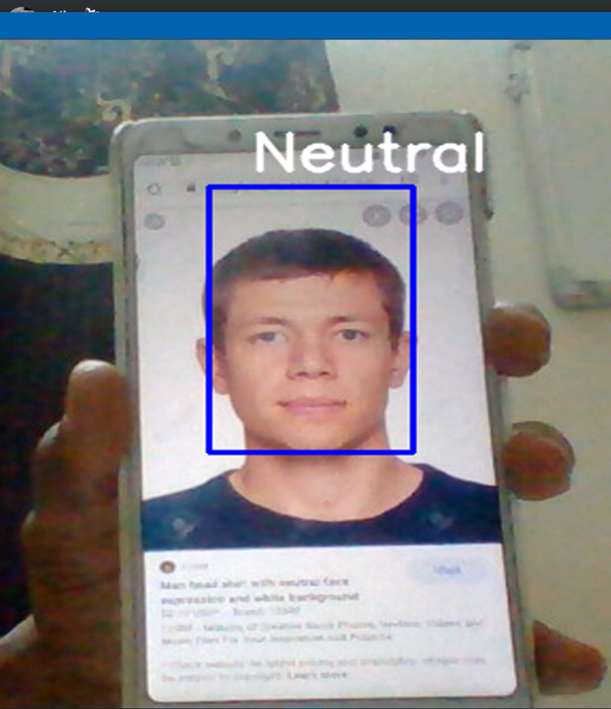
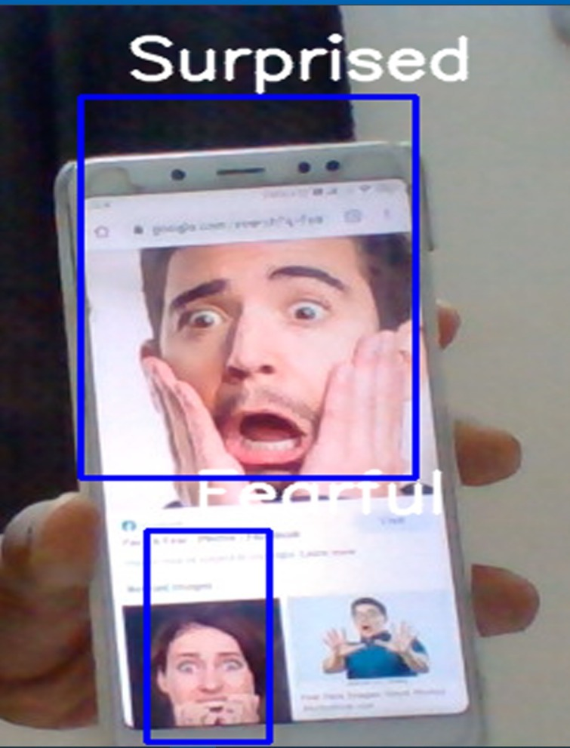
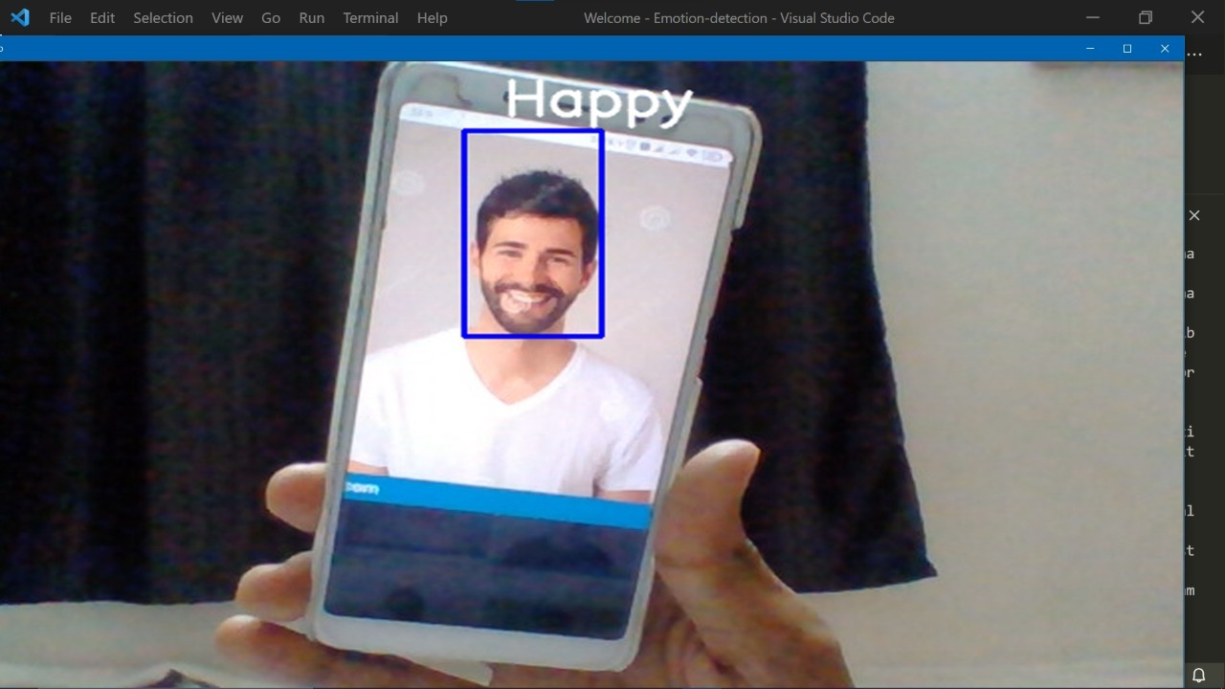
OUTPUT

Slide 10
Thank you

